Slide 1
Network Layer Routing Algorithm Link State Routing
Lecture 12 | CSE421 – Computer Networks
Department of Computer Science and Engineering School of Data & Science

Slide 2
Chapter 4: Network Layer
4. 1 Introduction
4.2 Virtual circuit and datagram networks
4.3 What’s inside a router
4.4 IP: Internet Protocol
Datagram format
IPv4 addressing
ICMP
IPv6
4.5 Routing algorithms
Distance Vector
Link state
Hierarchical routing
4.6 Routing in the Internet
RIP
OSPF
BGP
Notes:
2

Slide 3
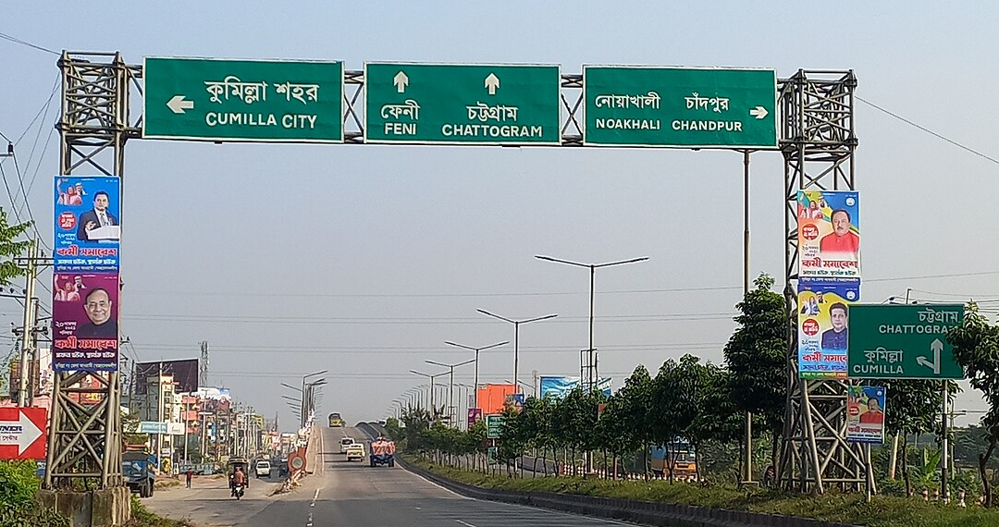
Distance Vector Routing Protocols
Distance Vector routing protocols are like road signs.
Routers must make preferred path decisions based on a distance or metric to a network.

Slide 4
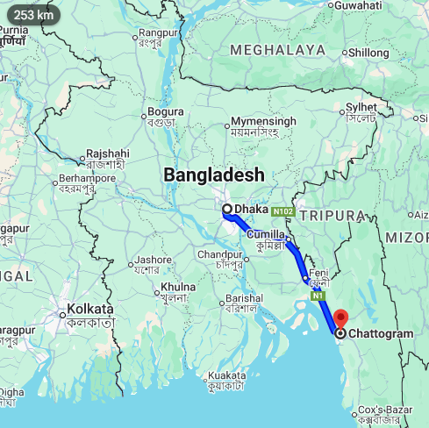
Link State Routing Protocols
Link-State routing protocols are more like a road map.
They create a topological map of the network
Each router uses this map to determine the shortest path to each network.

Slide 5

Link-State Routing Protocols
A centralized algorithm: finds the least-cost path using complete knowledge of the network.
Also called Shortest Path First (SPF) protocols.
Uses Dijkstra’s Algorithm to compute the shortest path from one node to all others.
Though it sounds complex, the basic idea is simple and easy to configure.

Slide 6
How it works
Uses Dijkstra’s Algorithm (SPF).
Every router knows the full network map (topology + link costs
Each router computes the least-cost paths from itself to all other
The result is a forwarding/routing table (tells where to send packets)
Algorithm runs in steps: after k iterations, the router knows the best path to k destinations.
Notes:
6

Slide 7
Link-State Routing Process
5 Step Process :
Each router learns its directly connected networks.
Each router talks to its neighbors (sends Hello packets).
Each router creates a Link-State Packet (LSP) describing its links.
Each router floods its LSP to all other routers.
Every router builds a complete network map from all LSPs and runs Dijkstra to find the best paths.
Notes:
How does a link-state routing protocol work?
How does a link-state routing protocol work?

Slide 8
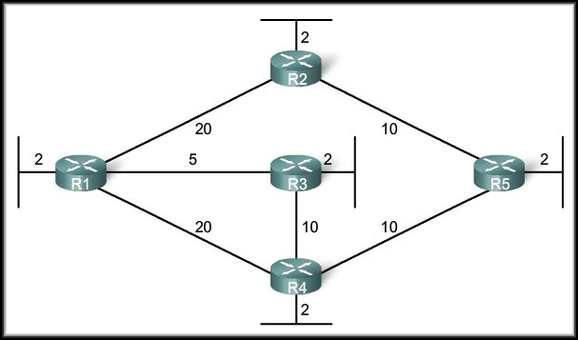
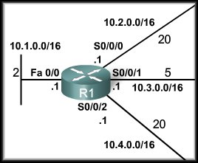
Step 1: Directly Connected Networks
We will focus on the Link-State routing process from the perspective of R1.
Each router learns about its own directly connected networks.
When a router interface is configured with an IP address and subnet mask and activated, the interface becomes part of that network.
Regardless of the routing protocols used, these directly connected networks are now part of the routing table.

Slide 9
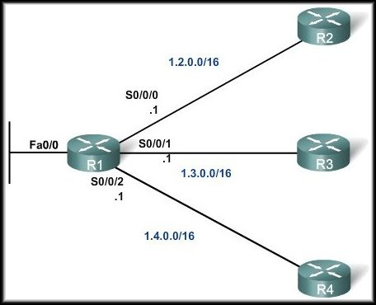
Step 2: Hello Packets
Each router is responsible for contacting its neighbors on directly connected networks.
The router will not be aware of any neighbor routers on the link until it receives a Hello packet from that neighbor.
At that time, it establishes an adjacency with the neighboring router.

Slide 10
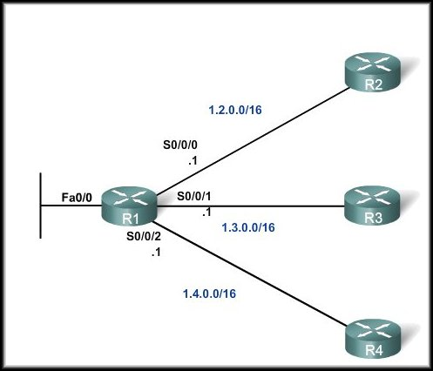
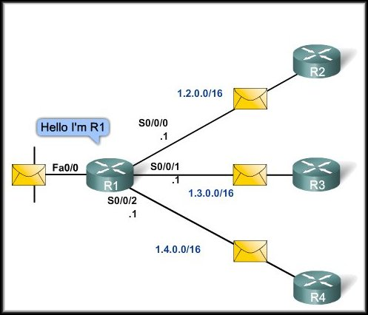
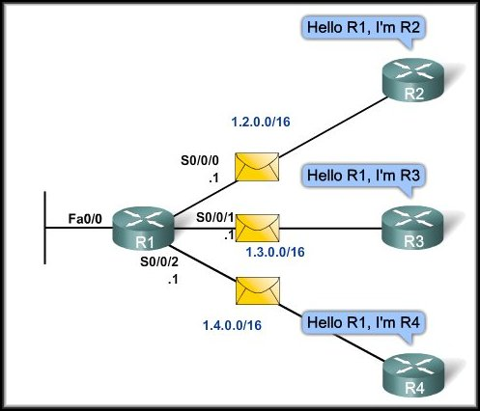
Step 2: Hello Packets

Slide 11
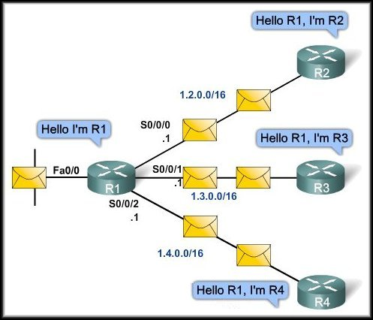
Step 2: Hello Packets
A neighbor is any other router that is enabled with the same link-state routing protocol.
These small Hello packets continue to be exchanged between two adjacent neighbors.
These packets serve as a keep alive function to monitor the state of the neighbor.

Slide 12
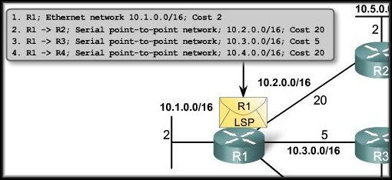
Step 3: Build the Link-State Packet
Each router builds a link-state packet (LSP) containing the state of each directly connected link.
The LSP contains the link-state information about the sending router’s links.
The router only sends LSPs out interfaces where it has established adjacencies with other routers.

Slide 13
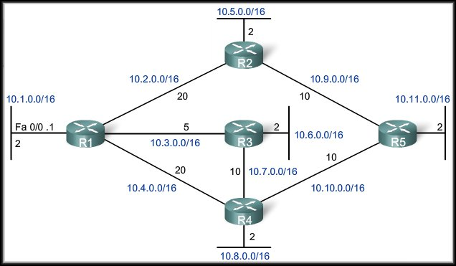
Step 4: Flooding Link-State Packets
No response to Hello – no LSP sent.
Flooding of R1 LSP
Each router floods the LSP to all neighbors, who then store all LSPs received in a database.
Whenever a router receives an LSP from a neighboring router, it immediately sends that LSP out all other interfaces, except the interface that received the LSP.

Slide 14
Step 4: Flooding Link-State Packets
Link-state routing protocols calculate the SPF algorithm after the flooding is complete.
As a result, link-state routing protocols reach convergence much faster than distance vector routing protocols.

Slide 15
Step 4: Flooding Link-State Packets
An LSP needs to be sent only:
During initial startup of the router or routing protocol.
Whenever there is a change in the topology (link going down or coming up) or a neighbor adjacency being established or broken.

Slide 16
Step 5: Constructing a Link-State Database
Each router uses the LSPs to construct a database that is a complete map of the topology and computes the best path to each destination network.

Slide 17
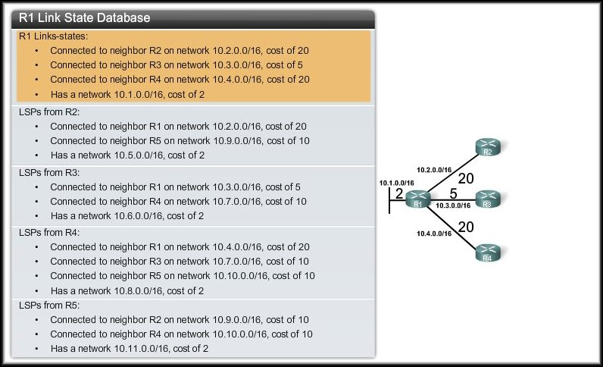
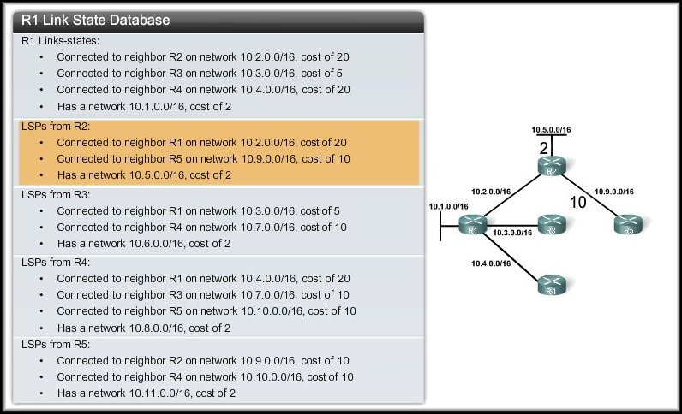
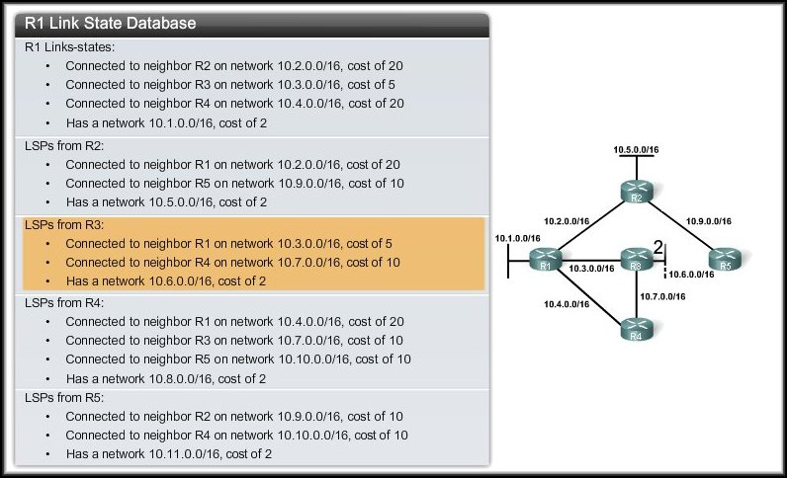
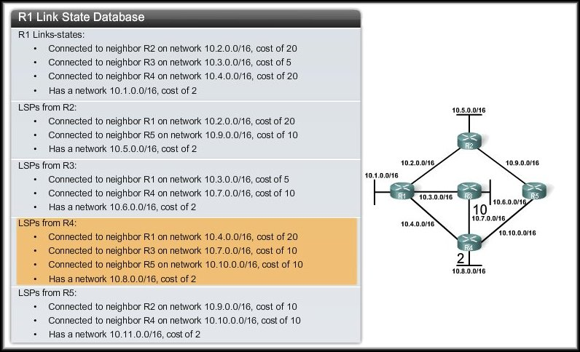
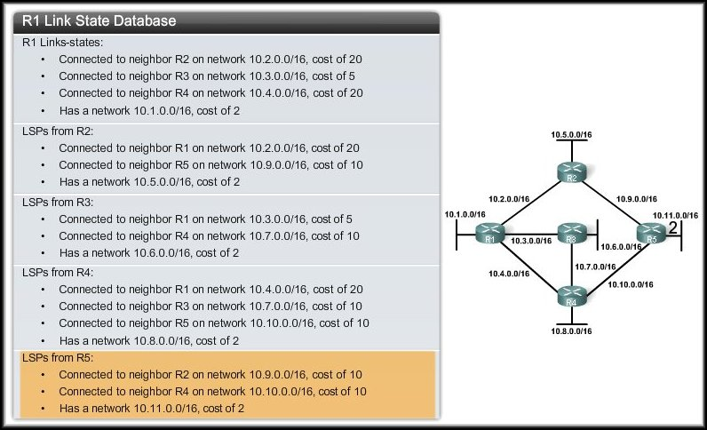
R1: Building the SPF Tree

Slide 18
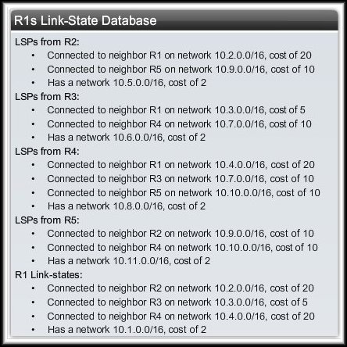
Step 5: Constructing a Link-State Database
As a result of the flooding process, router R1 has learned the link-state information for each router in its routing area.

Slide 19
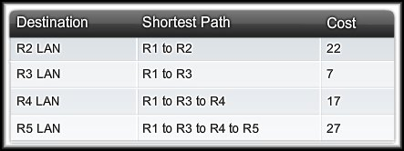
Step 5: Constructing a Link-State Database
Each router in the topology determines the shortest path from its own perspective.
With a complete link-state database, R1 can now use the database and the shortest path first (SPF) algorithm to calculate the preferred path or shortest path to each network.

Slide 20
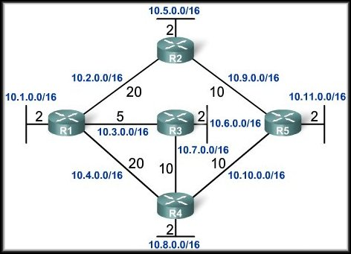
R1: Building the SPF Tree
Root
All LSPs have been processed using the SPF algorithm and R1 has now constructed the complete SPF tree.

Slide 21
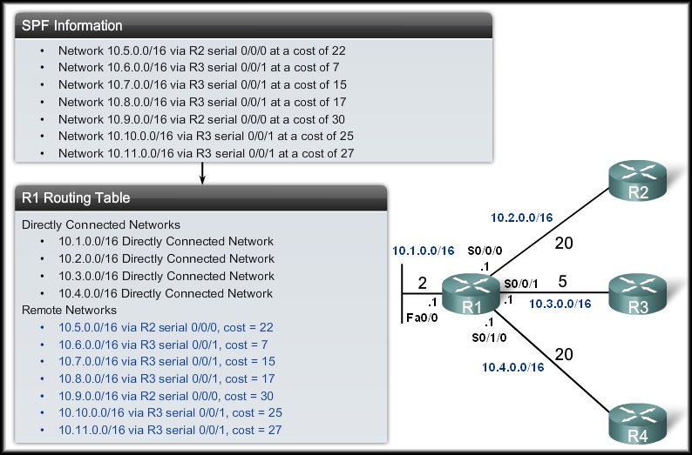
Generating a Routing Table

Slide 22
Building Routing Table
Creation of the states of the links by each node, called the link state packets (LSP)
Dissemination of LSPs to every other routers, called flooding (efficiently)
Constructing a Link-State Database using LSPs
Formation of a shortest path tree for each node
Calculation of a routing table based on the shortest path tree

Slide 23
Advantages: Link-State Routing
Fast Network Convergence–
When a router receives a new LSP, it quickly floods it to all other routers.
Updates spread very fast across the network.
Topological Map–
Each router builds a complete map of the network (SPF tree).
From this, it can calculate the shortest path to every destination.

Slide 24
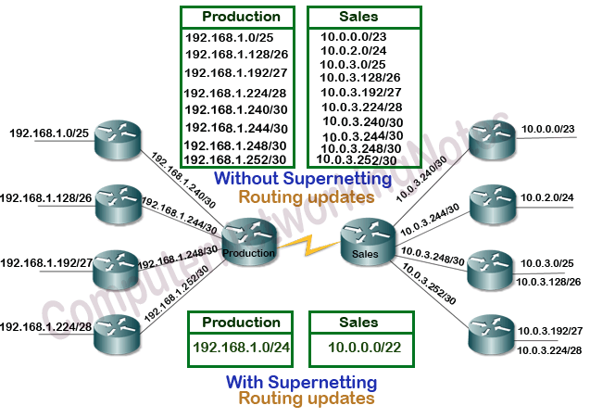
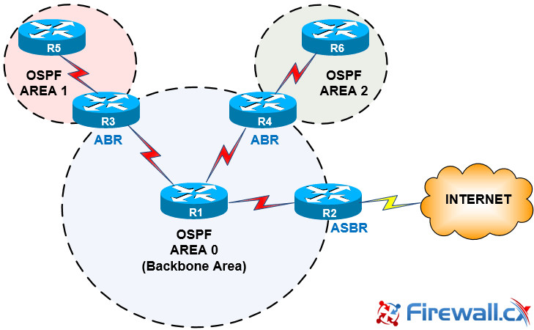
Advantages: Link-State Routing
Hierarchical Design–
Large networks can be divided into areas.
This helps in summarizing routes and makes the network easier to manage.
Event-driven Updates–
After the first flooding, updates are sent only when something changes (like a link goes down).
Only the changed info is shared, not the whole table.

Slide 25
Comparison
 | Distance Vector | Link State
Network view | Topology knowledge from the neighbor point of view | Common and complete knowledge of the network topology
Best Path Calculation | Based on fewest number of hops | Based on the link cost
Updates | Full routing table | Link State Updates
Algorithm | Bellman-Ford | Dijsktra
CPU and Memory | Low utilization | Intensive
hierarchical Structure | No | Yes
Convergence time | Moderate | Fast

Slide 26
THE END

